Slide 1
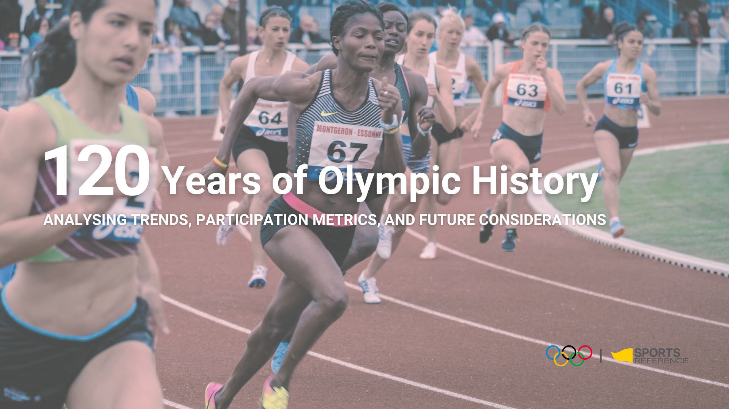

Slide 2
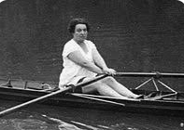
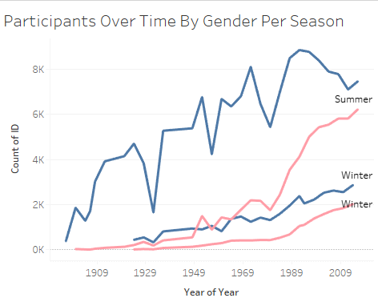

PROBLEM DEFINITION & CONTEXT
The Olympic Strategy
With Paris 2024 and LA 2028 on the horizon, the Olympic Committee should aim to enhance female participation.
Hypothesis: A higher presence of successful female athletes from a country positively impacts the participation of women from that country in the Olympics.
The vision: An Olympics where women's participation is celebrated and encouraged at all levels.
Main Goal: Increase women's participation and representation across all Olympic events.
OUR ASK: IDENTIFY PRIME LOCATIONS THAT OPTIMIZE WOMEN'S PARTICIPATION THROUGHOUT THE OLYMPICS
Enter graph of participation thru the years
Notes:
Our problem statement delves into 120 years of Olympic history, focusing on a key challenge: How can we strategically increase women's participation? By focusing on the evolution of female participation, evaluating the impact of host countries, and identifying consistent performers, we aim to uncover strategic avenues for boosting women's involvement in the Olympic Games.
WHEN OR HAVE WE WE BRIDGE THE GAP?
Women came into the Olympics in 1900. At the time out of 997 athletes 22 (2.2%) were women. Since then women participation has increased with its highest participation spike on YYYY
2020 = 48% (5,457 women out of 11,420 athletes)
1984 = 23% (1,566 women out of 6,829 athletes)
1964 = 13% (678 women out of 5,151 athletes)

Slide 3
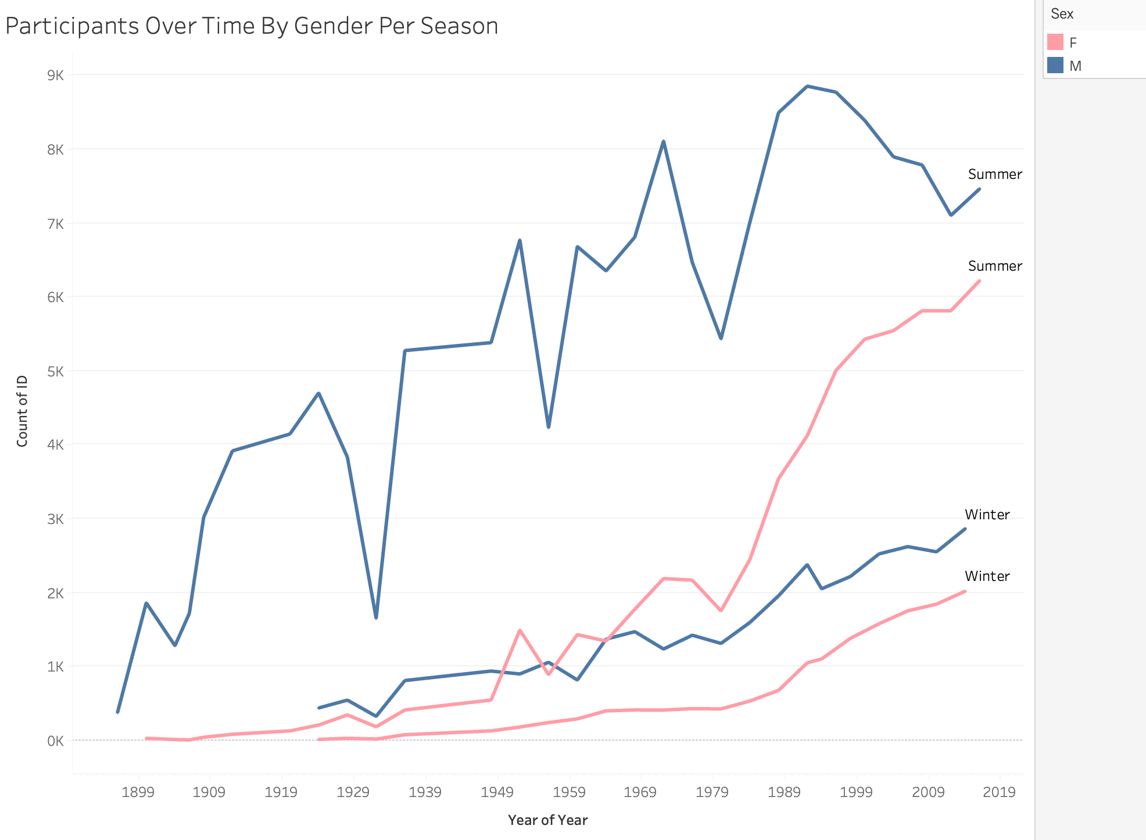

Slide 4

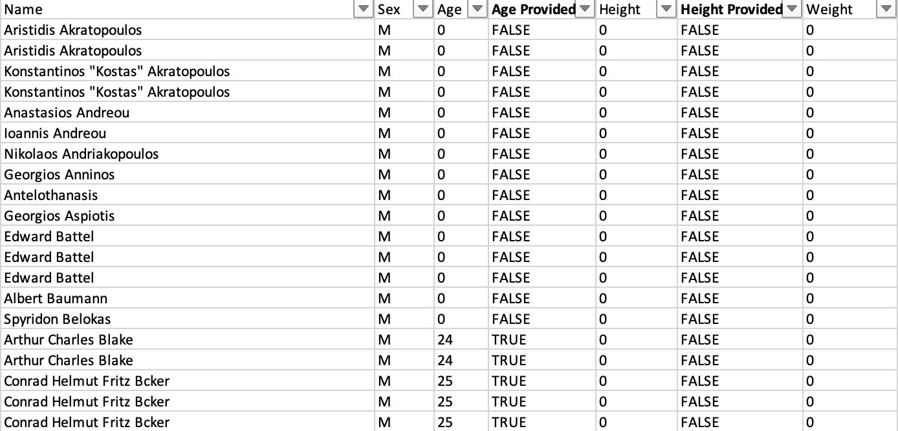
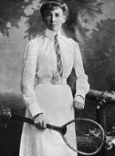
DATA SELECTION AND STRATEGIC CLEANING
Notes:
Our dataset, strategically sourced from Kaggle, forms our analysis. With a focus on women's participation, our data cleaning process involved meticulous handling of missing values and ensuring data consistency. Our statistical analysis, executed in Excel and visually represented using Tableau, uncovered strategic patterns and relationships.

Slide 5
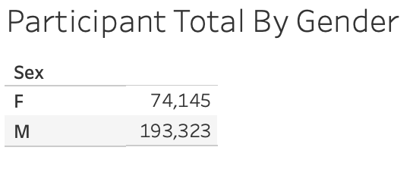
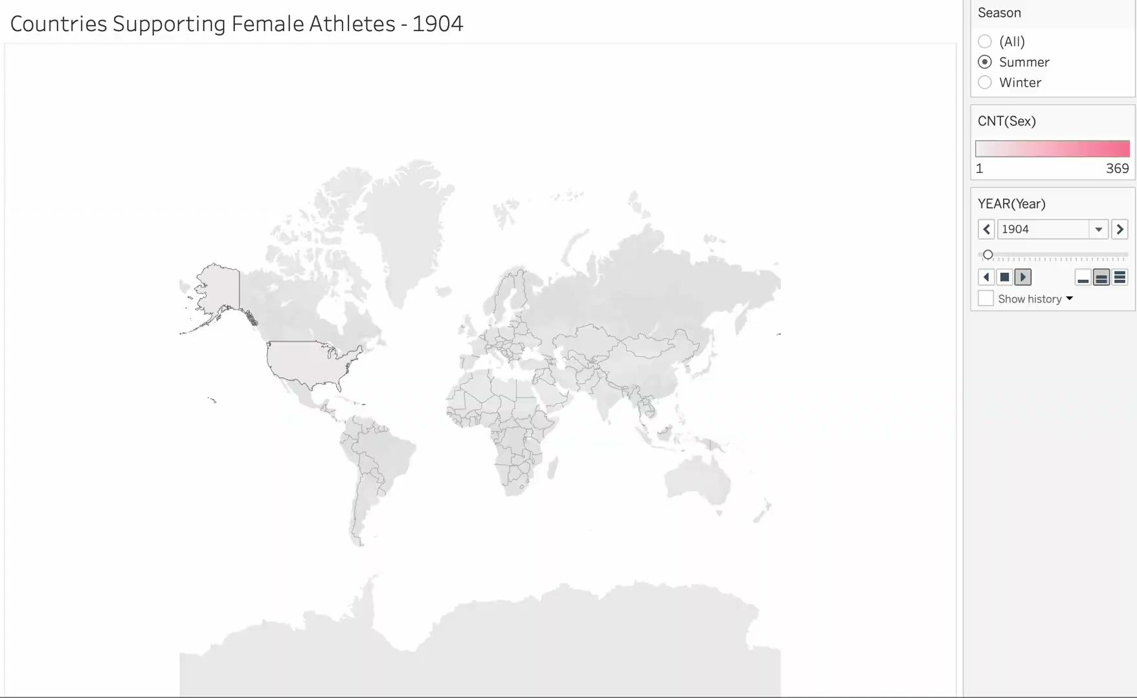
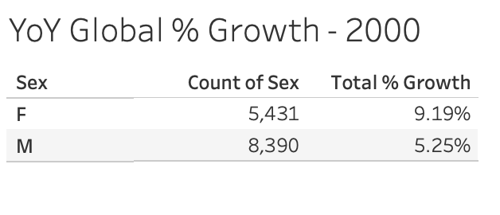
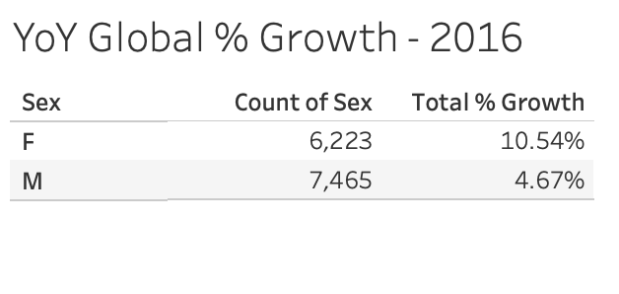
GLOBAL PARTICIPATION
Notes:
Since our problem statement leans towards women, we should consider this when providing stats on NOC participation. Note that the country mentioned is actually where the committee is registered not the athletes place of birth

Slide 6
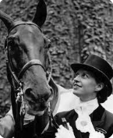
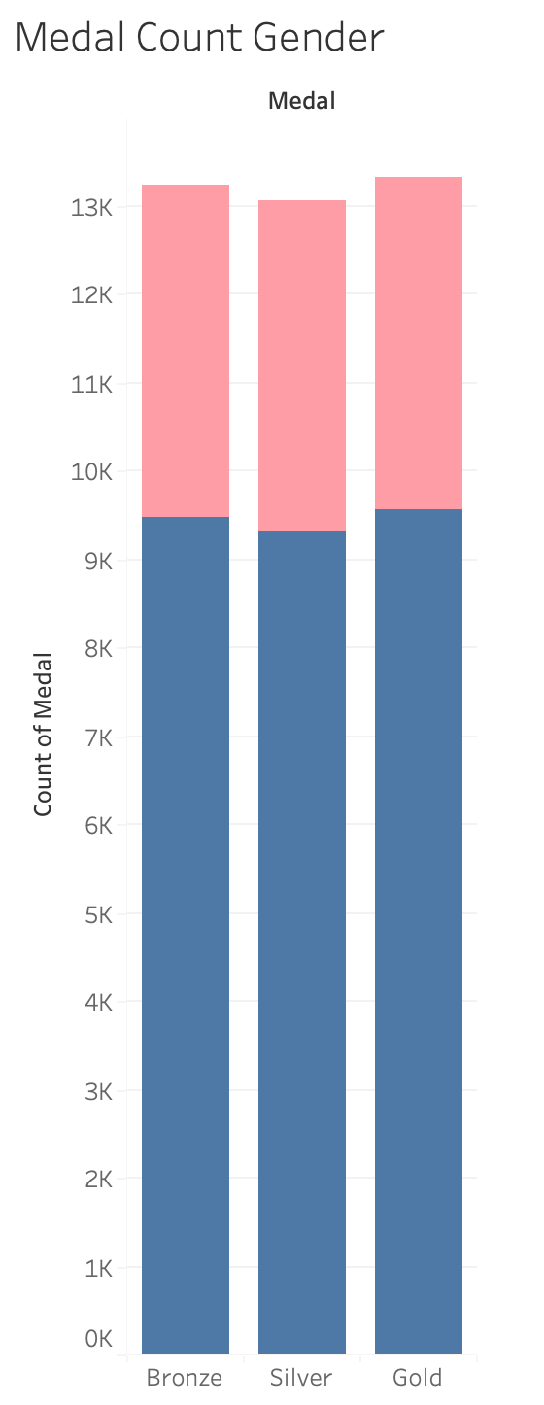
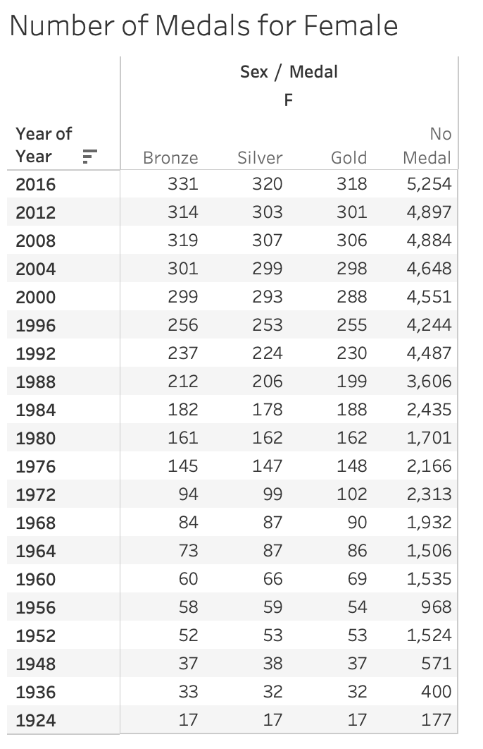
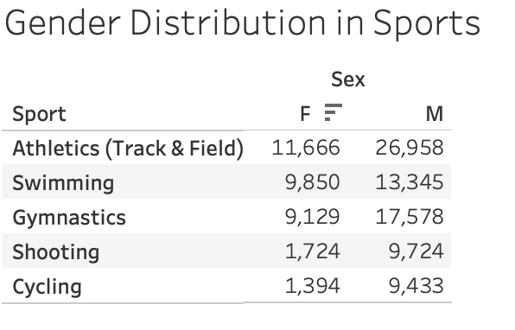
ATHLETE DIVERSITY
Notes:
Fun Fact
1900 modern Olympic games in Paris
Hélèn de Pourtalès of Switzerland
Of a total 997 athletes, 22 were woman
Sailing, Tennis, Croquet, Equestrianism & Golf

Slide 7
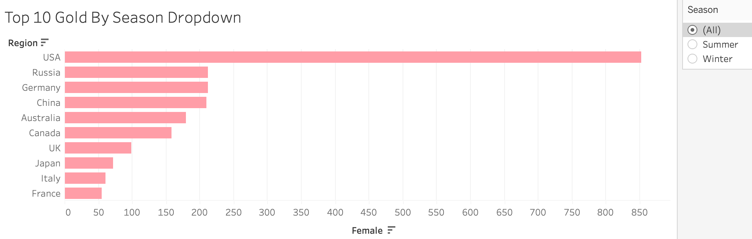
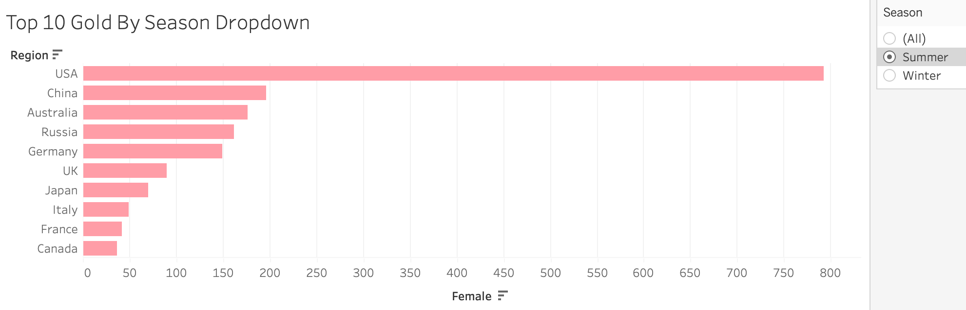
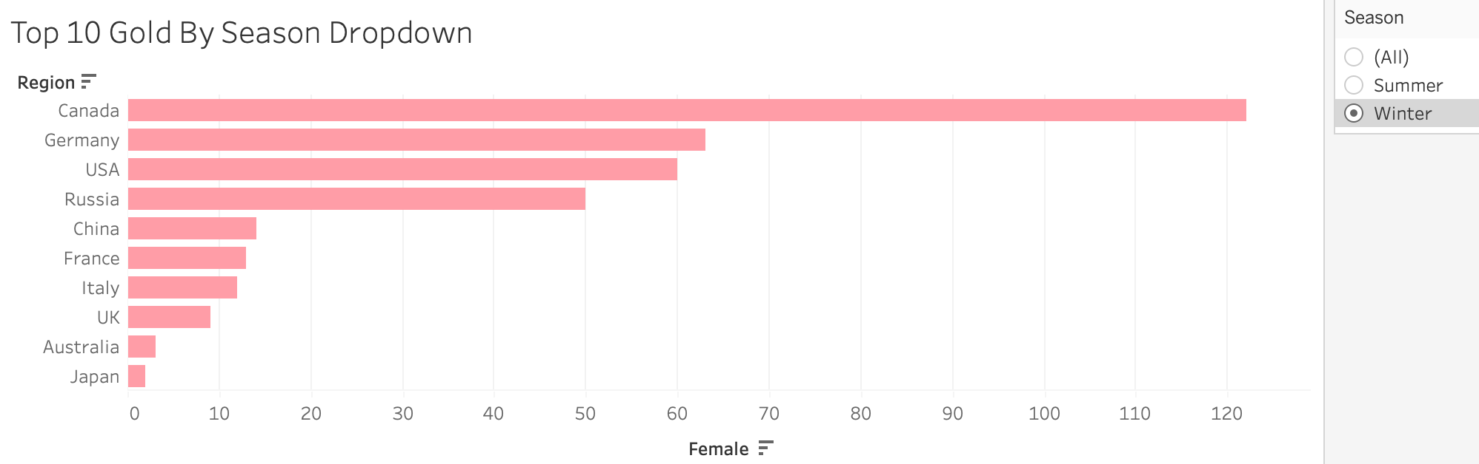

Slide 8
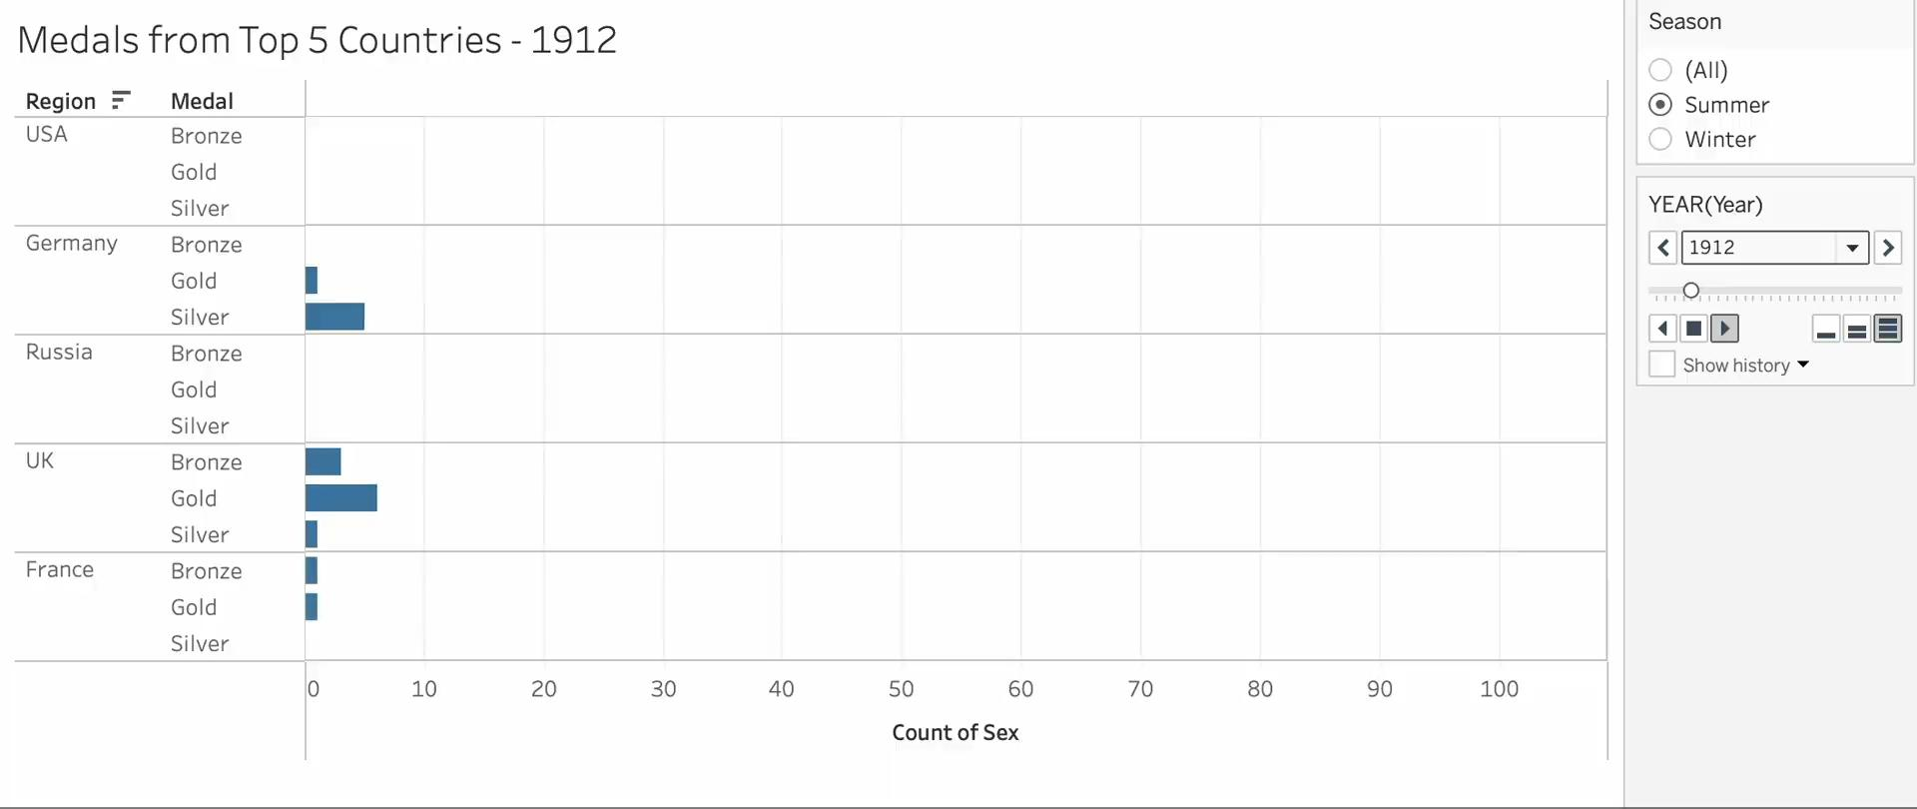
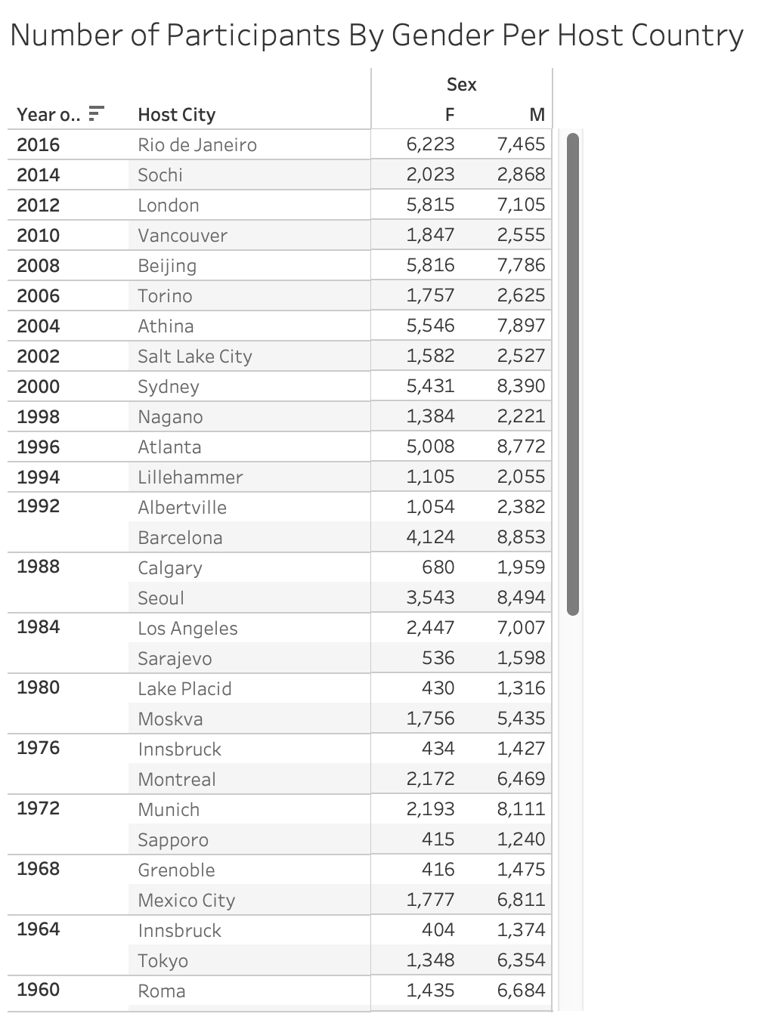
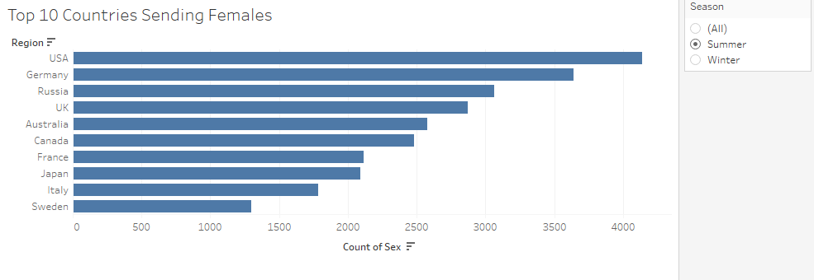
WOMEN ATHLETES OVER TIME
Notes:
In exploring the strategic relationship between host countries and medal success, we noted insights vital for strategic planning of future Olympic events.
Legendary Olympic gymnast Larissa Latynina dominated her sport, collecting a record breaking 18 medal haul between 1956 and 1964.
Since 2011, U.S. women have won gold in the team event at every world championship. Clinching that gold medal made Biles the most decorated female gymnast in history with 30 medals – topping Larisa Latynina of the Soviet Union

Slide 10
If a country is young in its chronological age, then it is notable that winning a medal at this point may have counted for another country in the past.
Considerations
Kosovo has one medal, as of 1990, but was previously considered part of Serbia
War impacts how people are able to compete for their birth country.

Slide 11
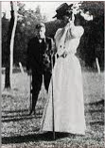
NEXT STEPS & BEST PRACTICES
Utilize historical data to forecast participation trends for Paris 2024 and LA 2028.
Analyze the correlation between unique uniform designs and athletic success.
Determine the relationship of financial investments in Olympic teams and athletic performance.
Explore the correlation between a country's economic indicators (GDP, population size, etc.) and its success in the Olympics.
Targeted talent development for promising female athletes.
Partnerships and sponsorships committed to promoting gender equality in sports.
Notes:
Utilising historical data, our forecast strategically anticipates the Olympic Games, predicting participation trends and medal outcomes for Paris 2024 and LA 2028. We explore if unique uniforms correlate with success, investigate financial investments' impact, and examine historical events and economic indicators' influence on countries' Olympic success

Slide 12


